Slide 1

Insights
Module-1 Week-2 : Creational Patterns

Slide 2
Agenda
Singleton Pattern
Factory and Prototype Pattern
Builder Case Study
Refactoring to Patterns

Slide 3
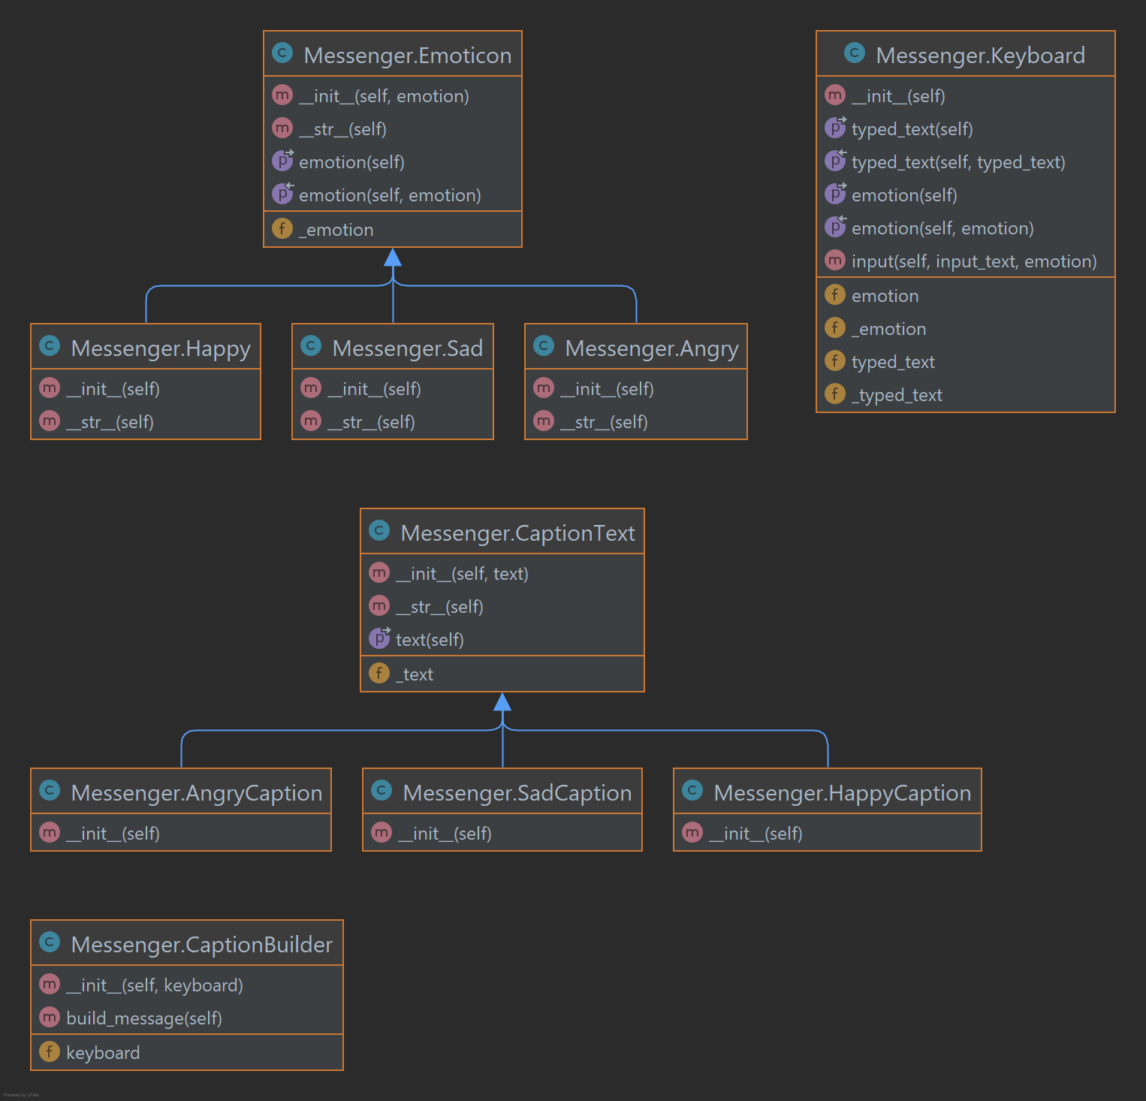
Naïve Messenger

Slide 4
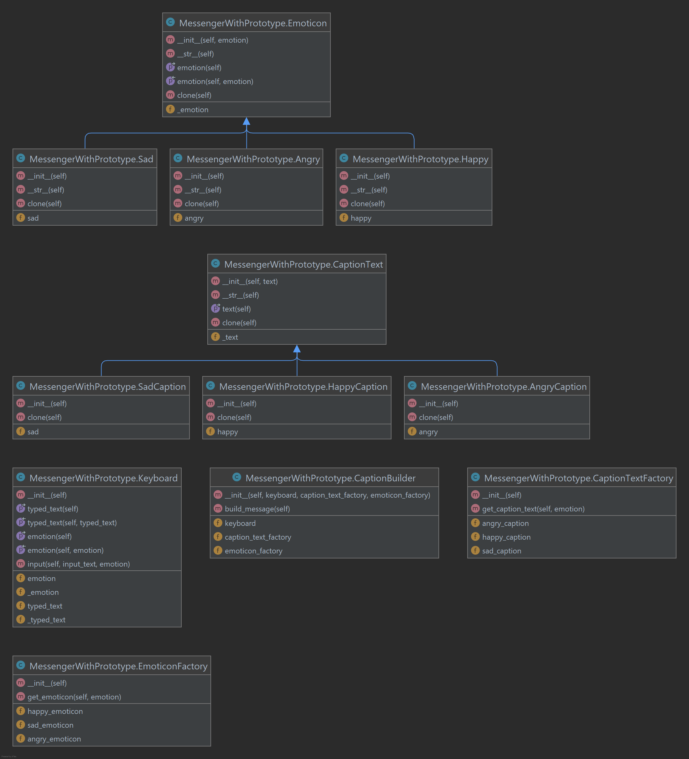
Prototype Messenger

Slide 5
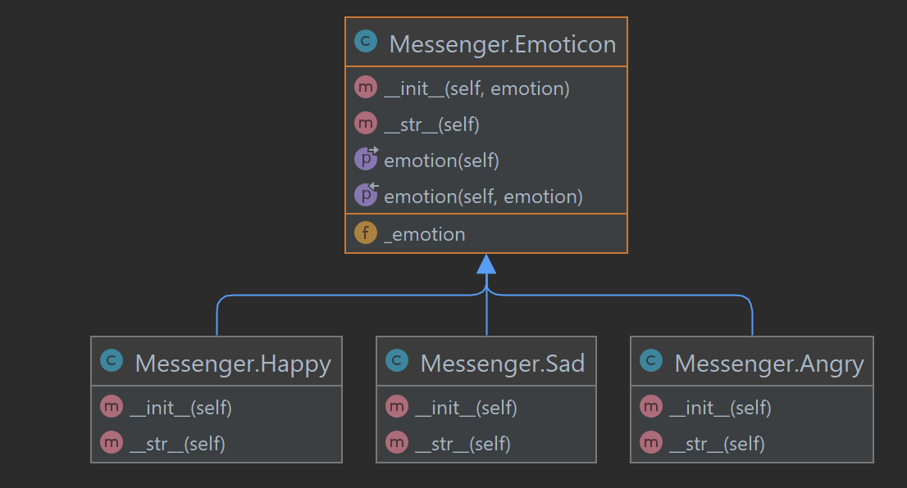
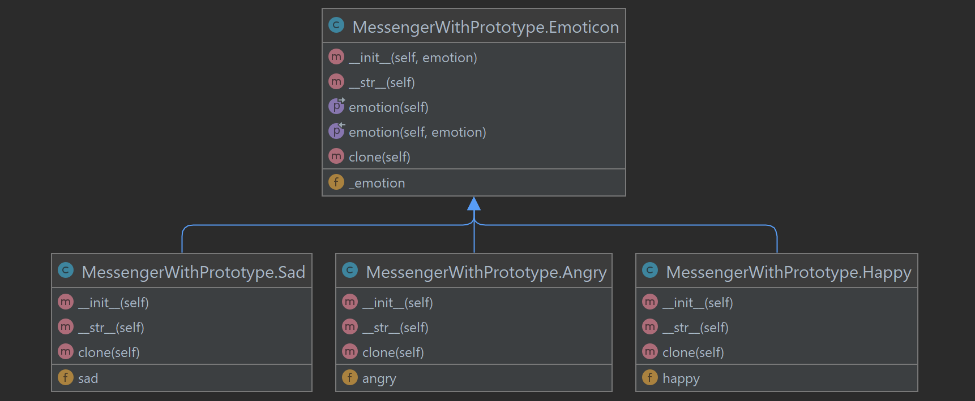
Prototype Emoticon Comparison

Slide 6
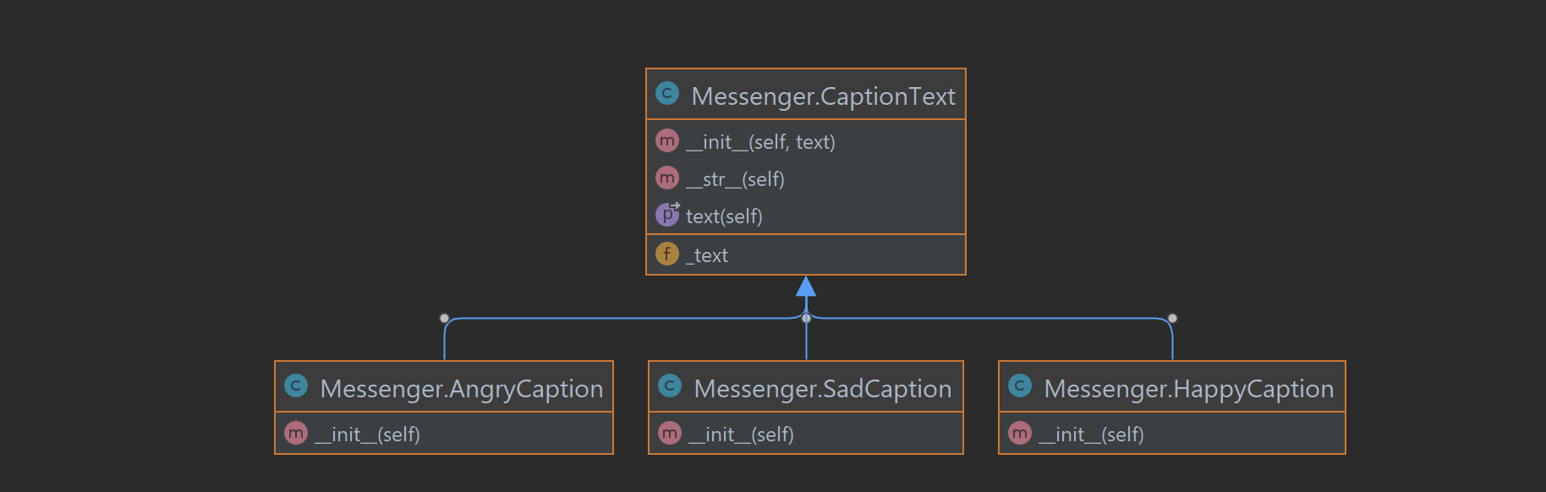
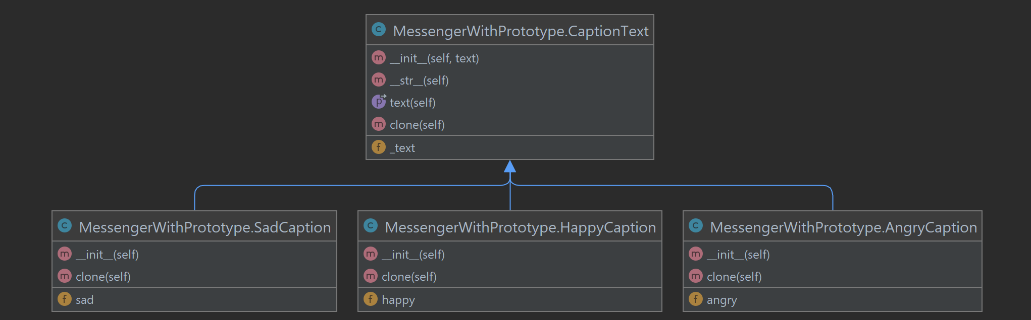
Prototype Caption Comparison

Slide 7
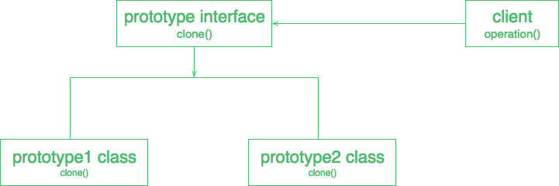
Prototype Design Pattern
Notes:
Clone Method

Slide 8
Builder Demo

Slide 9
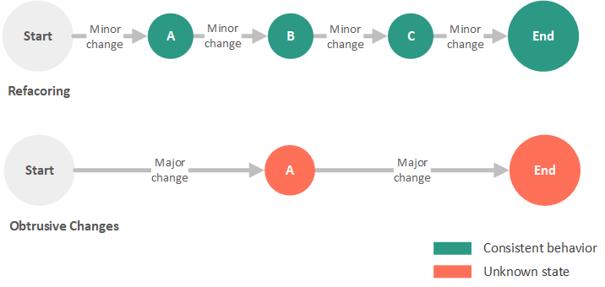

Slide 10
References
https://www.c-sharpcorner.com/article/prototype-design-pattern-easy-and-powerful-way-to-copy-obje/
https://developer.android.com/reference/android/app/AlertDialog.Builder
https://github.com/junit-team/junit5 - https://github.com/junit-team/junit5/tree/main/junit-jupiter-engine/src/main/java/org/junit/jupiter/engine/discovery
https://github.com/iluwatar/java-design-patterns
https://refactoring.guru/design-patterns/catalog
https://github.com/faif/python-patterns

